Slide 1
IMAGE SCRAPING AND CLASSIFICATION PROJECT
By Debanti roy

Slide 2
Business Problem Framing
The idea behind this project is to build a deep learning-based Image Classification model on images that will be scraped from e-commerce portal. This is done to make the model more and more robust.

Slide 3
Conceptual Background of the Domain Problem
Images are one of the major sources of data in the field of data science and AI. This field is making appropriate use of information that can be gathered through images by examining its features and details. We are trying to understand how an end to end project is developed in this field.

Slide 4
Motivation for the Problem Undertaken
The objective of image classification is to identify and portray, as a unique gray level (or color), the features occurring in an image in terms of the object or type of land cover these features actually represent on the ground. Image classification is perhaps the most important part of digital image analysis.

Slide 5
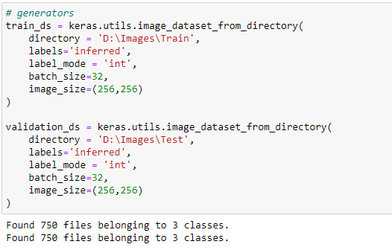
Data Sources and their formats
We have scraped images of sarees (women), jeans (men) and trousers (men) from an ecommerce site (Amazon) for training the data. For each category we have collected 250 images and have saved them as images and the record was stored in csv format.
We have also collected images separately for testing from websites like Flipkart and Amazon and saved them as images. The records are saved in csv format. Here each category consists of 250 images.

Slide 6
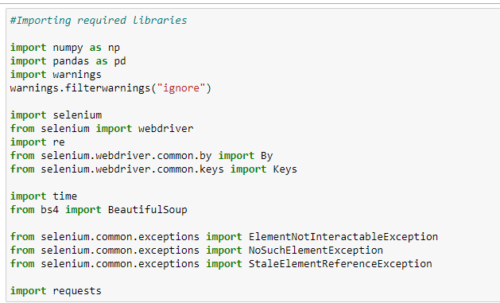
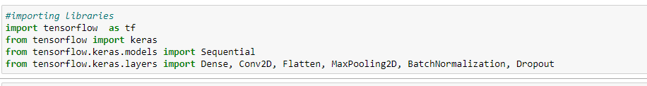
Importing Necessary libraries and Packages
For scraping data:
For training and testing data:

Slide 7
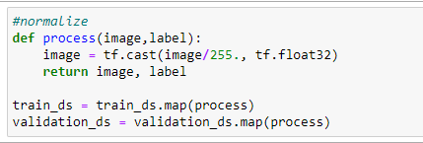
Normalization
Image Normalization is a process in which we change the range of pixel intensity values to make the image more familiar or normal to the senses, hence the term normalization. Often image normalization is used to increase contrast which aids in improved feature extraction or image segmentation.
We applied normalization to change the range of pixel intensity values to make the image more familiar.

Slide 8
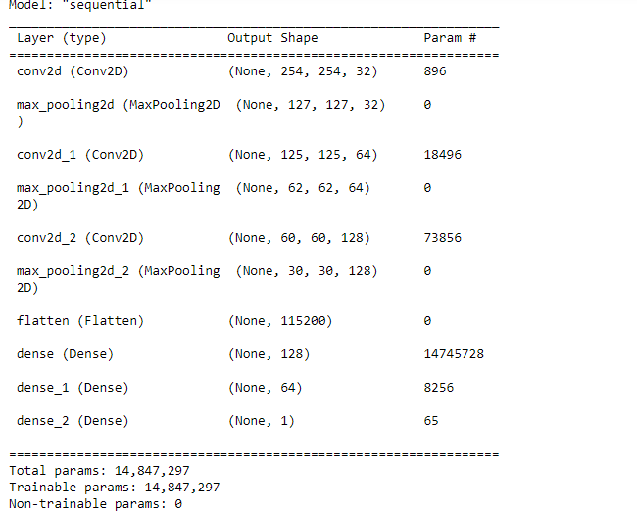
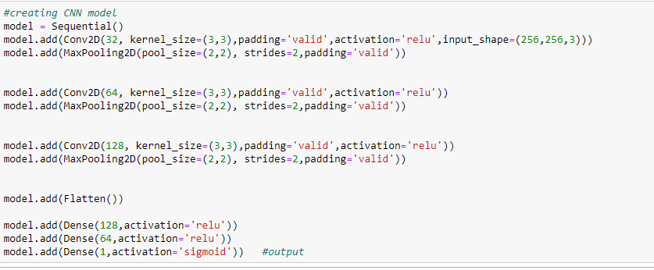
Run and Evaluate selected models
We checked the model structure with the help of model summary.
We have built a CNN model to train and then evaluate the performance model.

Slide 9
Visualizations

Slide 10
Testing of Identified Approaches (Algorithms)
We have applied the following for testing:
Conv2D,
MaxPooling2D
Dense
Our model performance was _____________at the end.
Therefore, to improve the performance we applied BatchNormalization and Dropout.
The performance improved to __________.

Slide 11
Interpretation of the Results
CNN Model Performance
Before applying BatchNormalization & Dropout
After applying BatchNormalization & Dropout

Slide 12
Learning Outcomes of the Study in respect of Data Science
This project helps us understand that CNN has a greater scope in Machine Learning and can offer more accurate results with more and more data. We can see the performance of our model has increased from ______________ to ____________, which is a good improvement.

Slide 13
Limitations of this work and Scope for Future Work
As we are working with a small dataset results might not be much accurate. However, CNN models are more effective with larger datasets.

Slide 14


